Slide 1
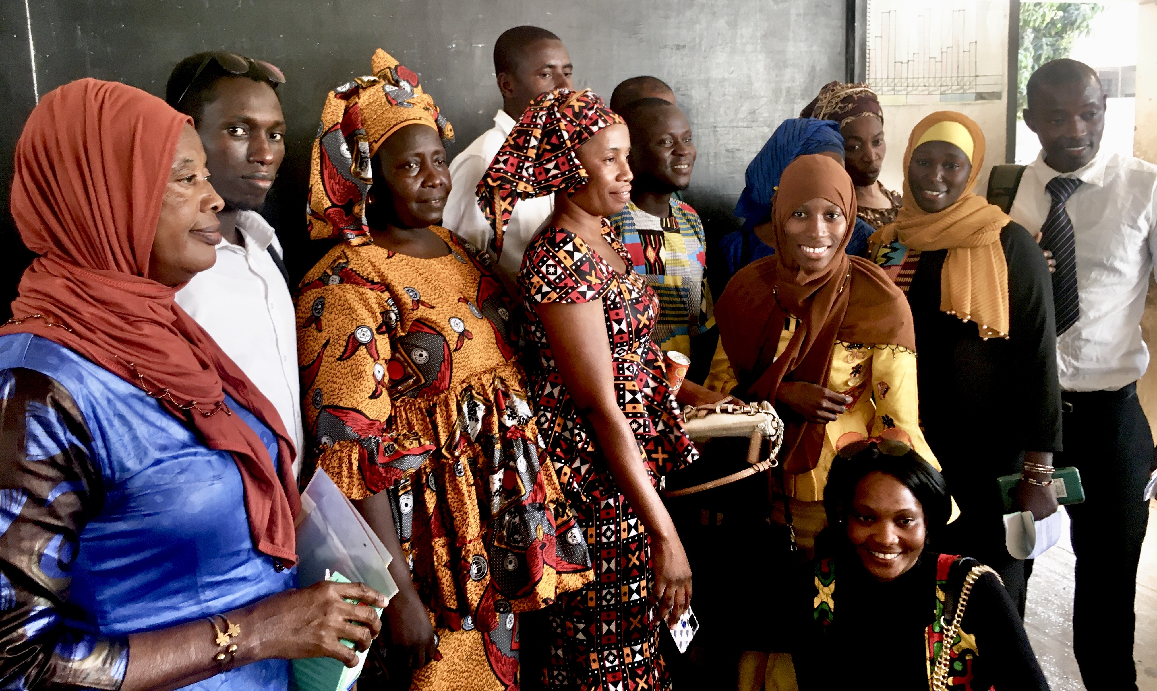
The Most
Important Day in a
Teacher's Life:
An Introduction to "Why We Learn"

Slide 2

Your Decision
The most important day in your career may be the day you decide to become a teacher.

Slide 3
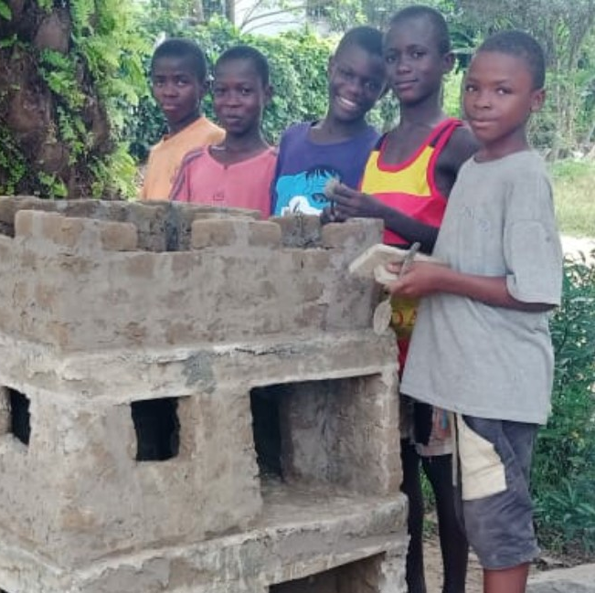
The Need
An effective teacher can inspire people in every other profession to maximize their human potential.
In an era such as this one, we will need people whose character, cognition, convictions and commitment to serve society show the evidence of thoughtful pedagogy and good teachers.

Slide 4

Peak Experiences illustrate Why We Learn
High motivation stems from not only on what and how we learn but why we learn.
If euphoria occurs naturally during creative peaks, it heightens when those peaks have a useful and altruistic purpose!
Through advance planning and teachable moments, teachers can generate regular opportunities to link cognition, creativity, collaboration and compassion, to foster daily peak experiences.

Slide 5
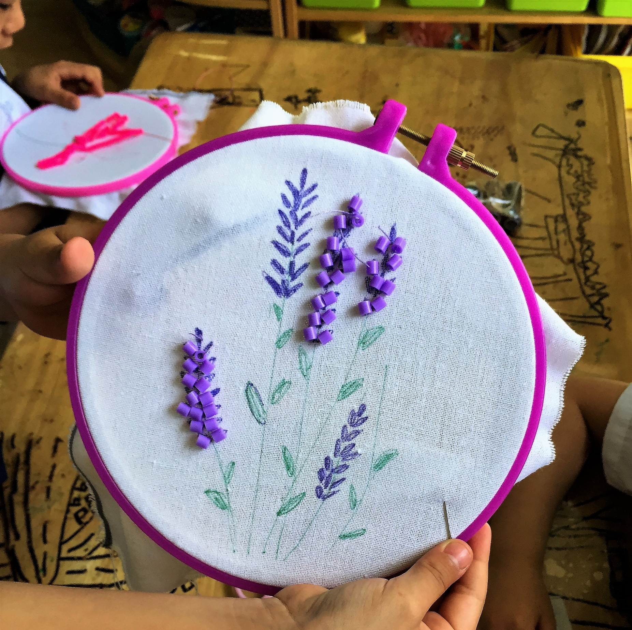
Work: Love Made Visible
Some schools operate on the principle that “Work is love made visible.”
Teachers become role models for students.
Family and community members then feel the love from learners.

Slide 6
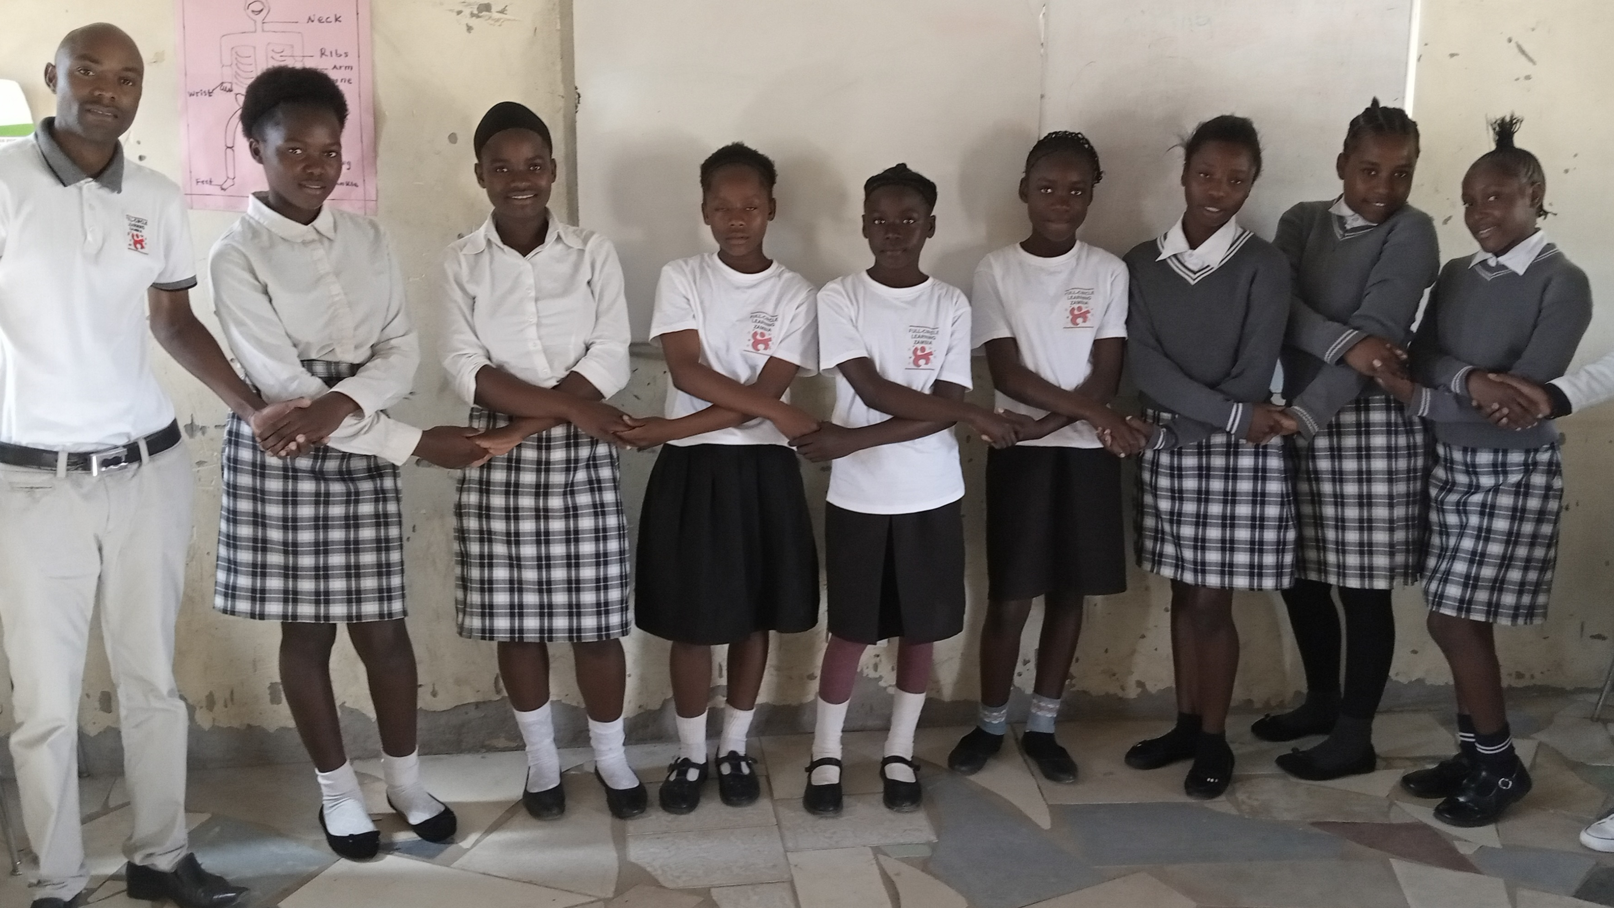
Observe How Peer Identity Influences Learning
How wide is a learner’s circle of “family” upon entering your classroom?
Do your pedagogy and practice play a role in expanding the child's circle?
How do her new skills enhance life for others? Does this increase her motivation?

Slide 7
Influences on Peer Identity
In some cultures, a child is told to “own” objects before giving them away or to esteem the self before recognizing others.
In highly-connected societies, the child learns about the universe first, the community second, and personal needs third. The child may perceive that they play a small but integral role in the community’s survival from an early age.
These natural rites of passage sometimes help children avoid the identity crises of children without a sense of purpose in more developed communities.
Isn’t it a worthy goal to provide students with a sense of belonging by letting them gently apply their skills rather than waiting for true hardship to leave them feeling unprepared, less resilient and unneeded?

Slide 8
1,000 Diverse Adults Who
Initiated Humanitarian Projects
Independently shared their common childhood experiences, describing the chance, as children, to:
1) empathize with those who were different
2) bond with a caring adult role model, and
3) turn hardship into problem-solving opportunities.

Slide 9

Early Altruism Studies
Show Long-term Results
Infants studied in 2007 in Germany had an instinct for helping the researcher retrieve dropped objects.
In Full-Circle Learning programs, even two years-olds experience high motivation with giving as the impetus of the learning.
Longitudinal surveys and anecdotes show consistent examples of emerging leaders when the child’s education prioritizes altruistic norms equally with intellectual outcomes.

Slide 10
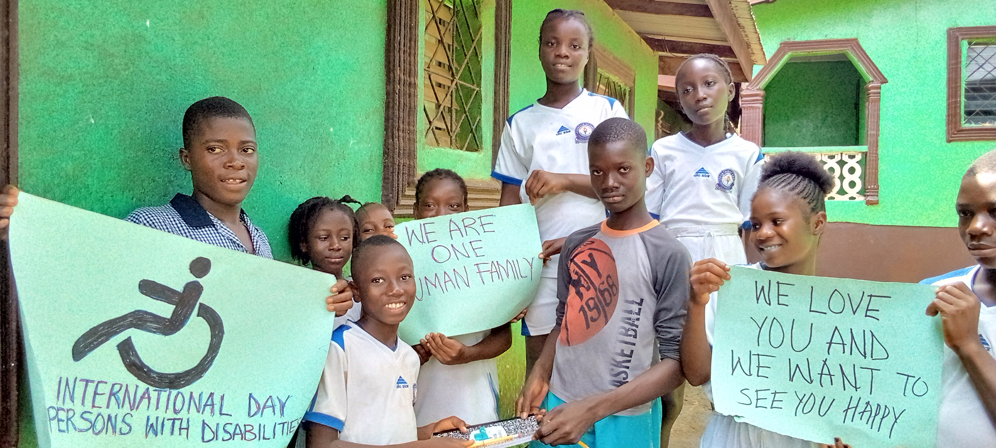
Identity Matters
Multiple studies have reinforced the effectiveness of two strategies begun 30 years ago:
Classroom peers identify as compassionate members of one human family.
Schools name their grade levels not numerically but, rather, based on the thematic habits-of-heart they will pursue. (e.g. the Helpers, the Humanitarians, the Peacemakers, the Change Agents, etc.)
(Their units will link academics to community challenges related to unit these such as kindness, advocacy, appreciation of diversity, acting on convictions, etc.)

Slide 11
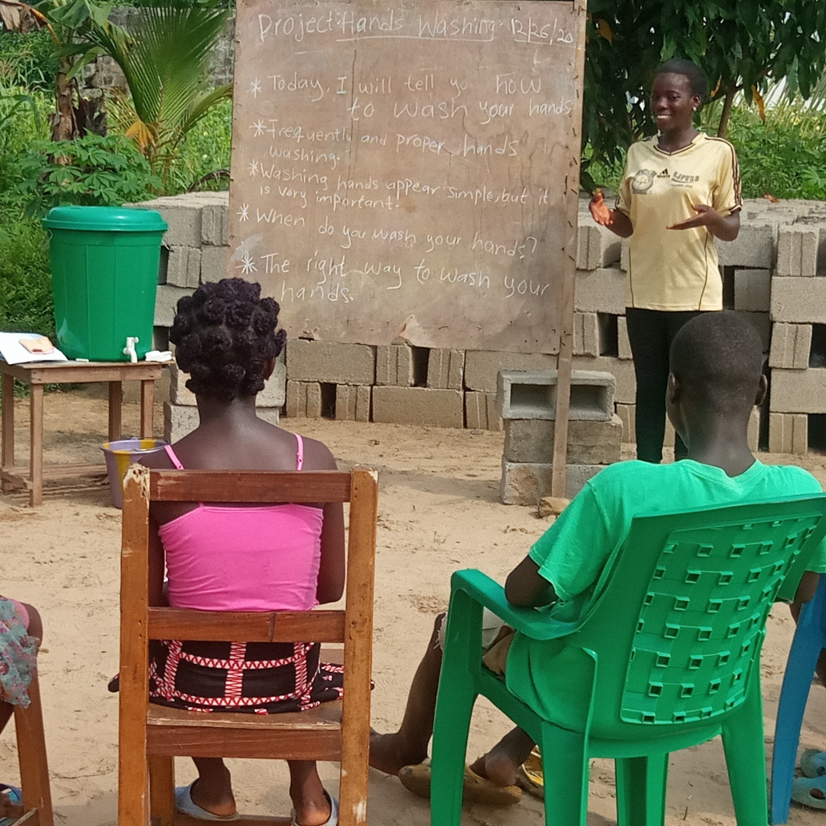
Projects Present Teaching as
Community
Participation
Humans learn 70% more effectively by teaching a skill than by simply hearing or seeing information.
As students teach others, they expand their sense of service.
Their teaching and exchanging of wisdom encompasses an increasingly wider breadth of the human family.

Slide 12
What can a good teacher help a class do?
Teachers have helped students integrate their skills to teach people in the local and global community, solving dilemmas and addressing sustainable development goals such as these (among hundreds of others):
Bringing light to the homes of elders
Assisting victims of weather extremes, earthquake or natural disaster
Reducing health disparities and preventing diabetes, malaria, typhoid, or cholera
Reducing food insecurity through community gardens, agronomy and nutrition for the vulnerable
Increasing racial harmony or tribal unification
Teaching climate change prevention, land management and regeneration
Teaching conflict resolution to prevent widespread civil unrest

Slide 13

Love: The “Why” in Why We Learn
Children left in foster care for even six months as babies had challenges that lasted throughout their school careers, in one study.
A loving teacher can turn despair into light.
Case studies show what happens when the teacher’s influence extends to the next generation.

Slide 14
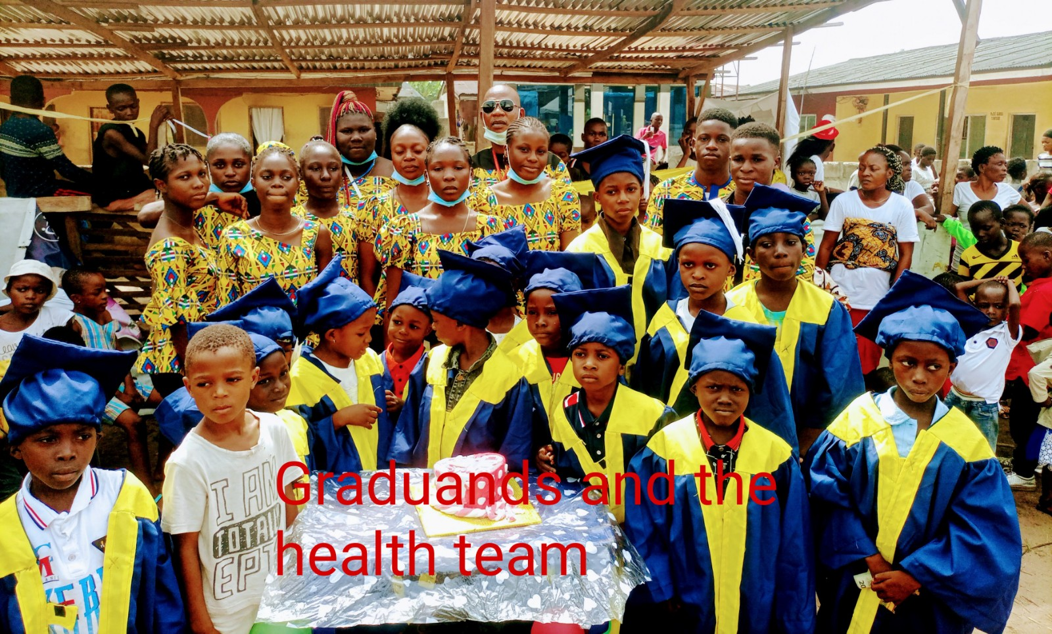
Who will Your Students Become?

Slide 15


Anticipating the Human Connection Before Birth
Heartbeat of fetuses seeing laser-dot faces reinforce the toddler study.

Slide 16

Create your own Butterfly Effect

