Slide 1


Sample 13-S Learning Unit
Habit-of-Heart: Unity
Community Challenge: Water for Life

Slide 2
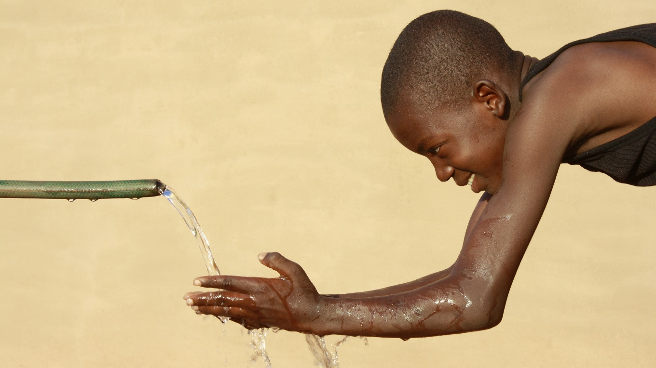
1. Sense it.
Introduce the theme and habit-of-heart through the senses

Slide 3

2. See it.
Unity

Slide 4

Say it.
Clap the syllables of the habit-of-heart with the class.

Slide 5

Shape it.
Draw a shape around the word that conveys its meaning
U-NI-TY

Slide 6

Symbolize it.
Example: H2O molecule in a watershed

Slide 7

Synchronize it.
Pitch and rhythm of the habit create a tradition

Slide 8
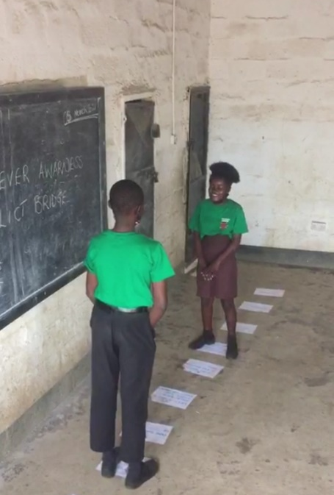
Show it.
Role play exercises that foreshadow or prep for upcoming project and instill the habit-of-heart

Slide 9
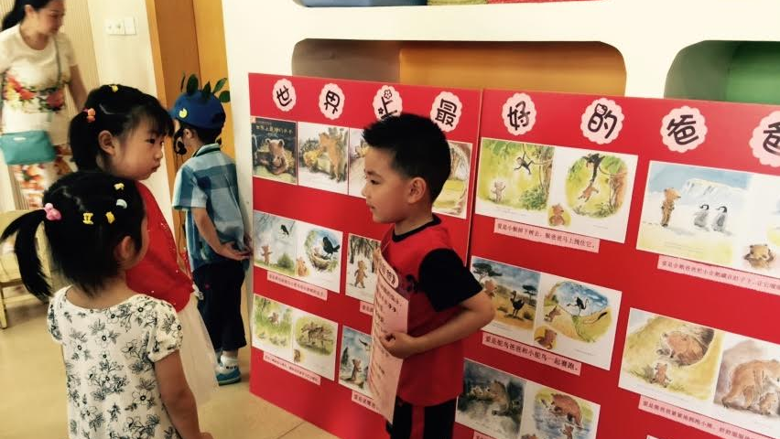
Storytell it.
Teach the habit-of-heart through literature

Slide 10
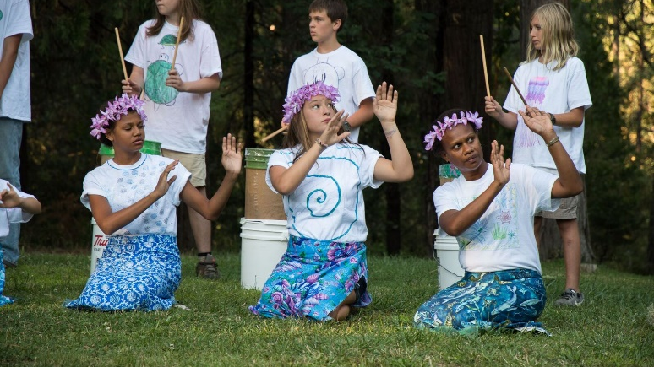
Sing it.
Projects incorporate music to advocate, educate or inspire

Slide 11
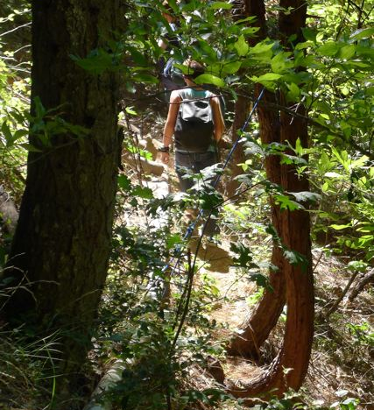

Standardize it.
Integrate the academic requirements and standards in your national syllabus

Slide 12
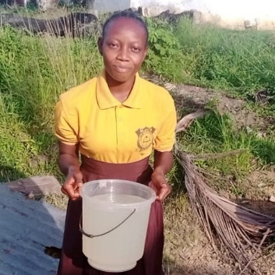
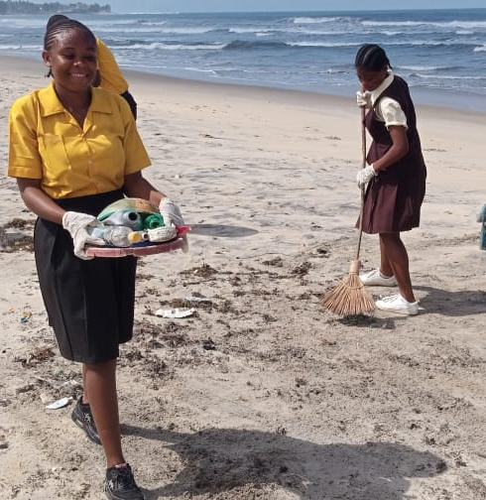
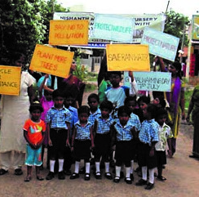
Share it.
Students teach, serve, uplift problem-solve, or transform the community based on the theme.

Slide 13
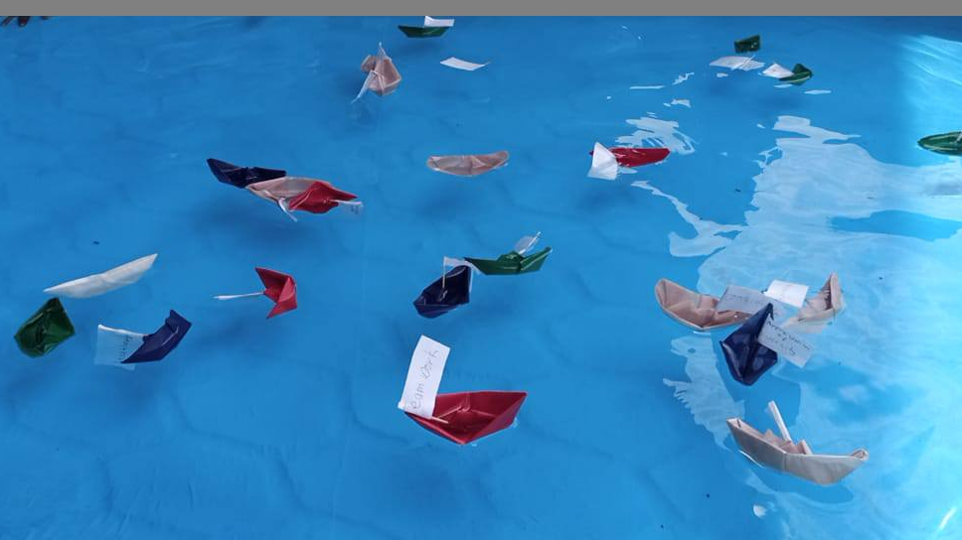
Send it.
Send research-based wisdom exchanges to schools, advocacy letters to officials or correspondence that honor someone for the habit-of-heart

Slide 14
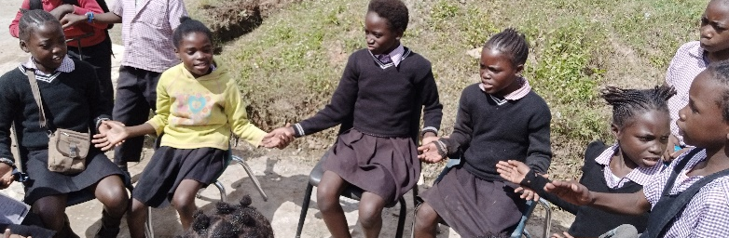
Sustain it.
Celebrate community benefits and commit to practice the habit-of-heart

